Slide 1
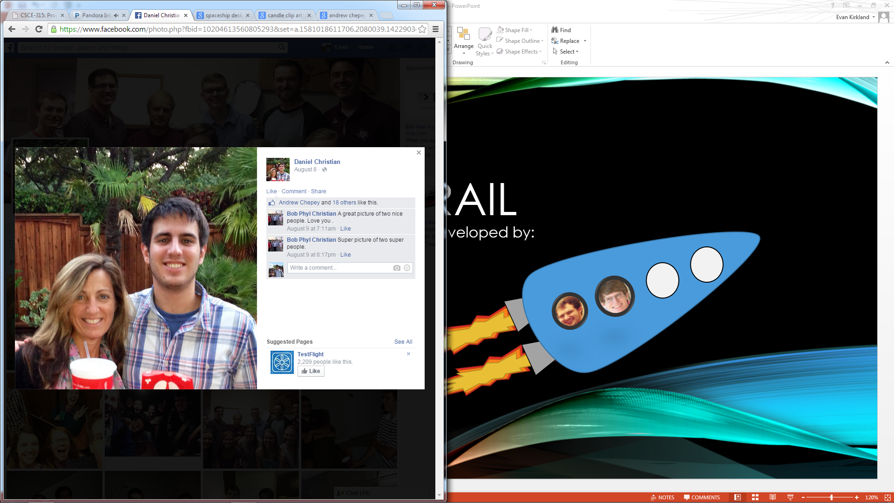
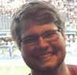
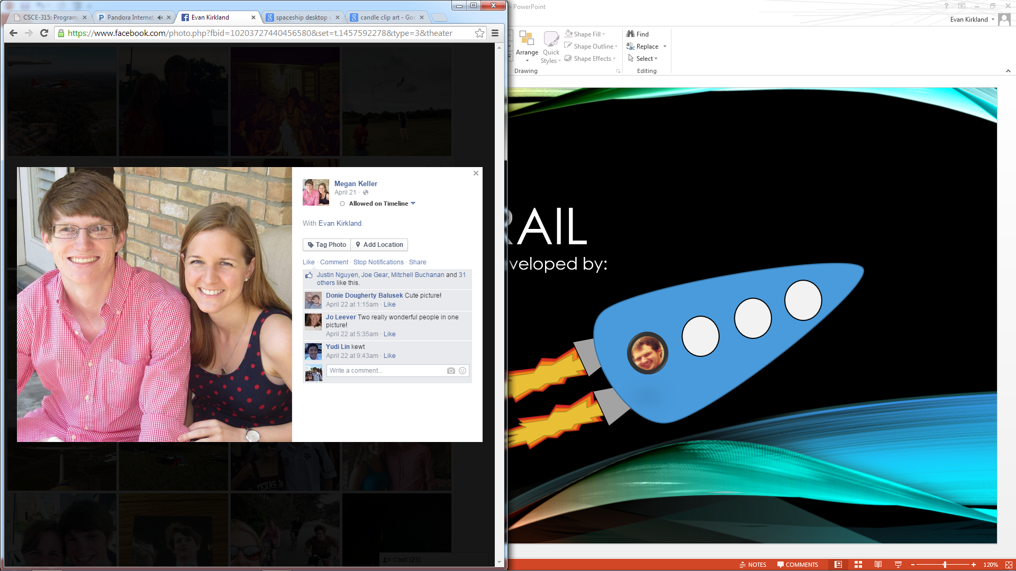
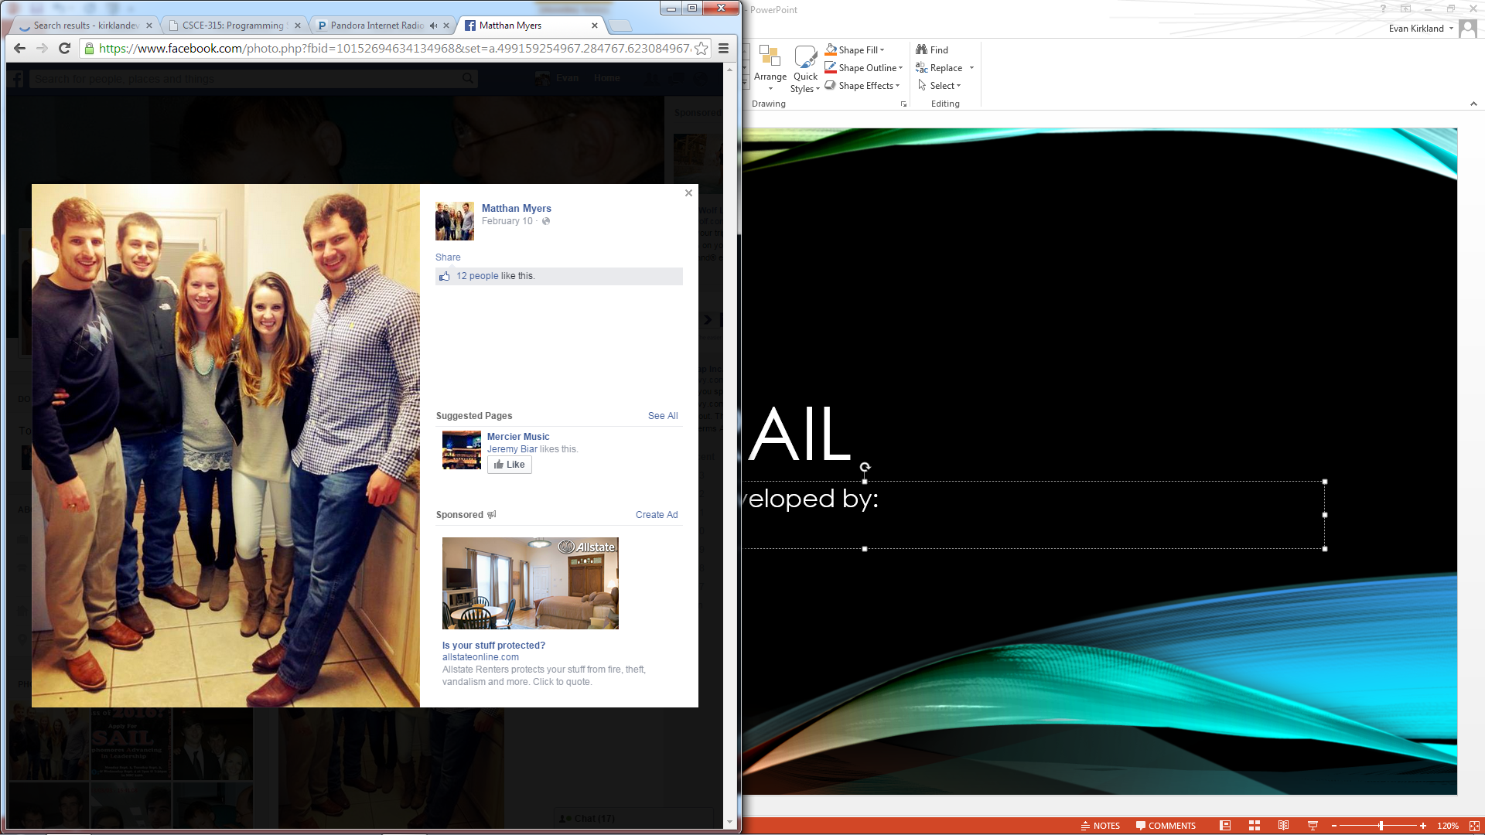
SPACE Trail
An Android application developed by:
Robert Christian
Andrew Chepey
Evan Kirkland
Matthan Myers
Team 19

Slide 2
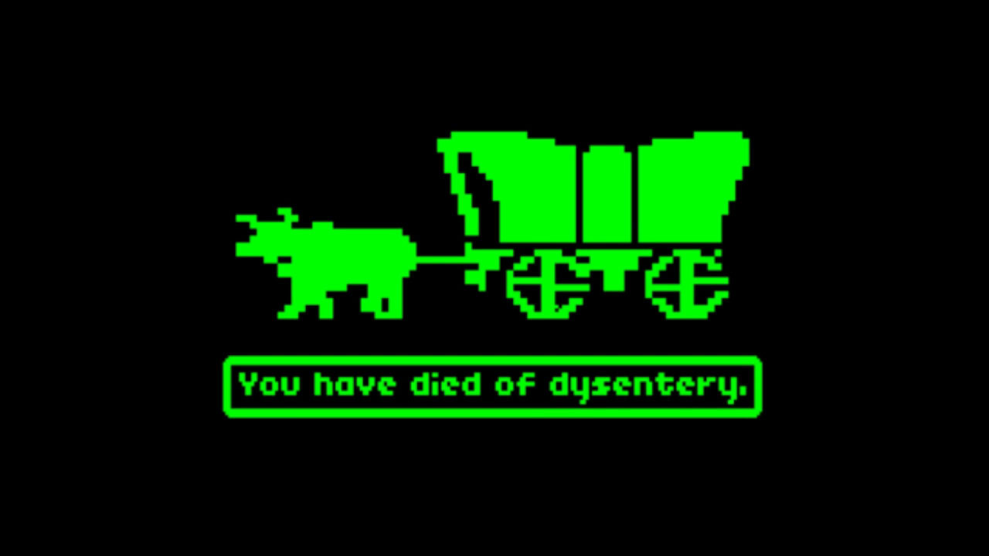
Concept & Design
Based on ‘Oregon Trail’
Astronomical data of solar system
XML usage for loading and saving
Objective is to visit all 9 planets
Pluto is being used as a ‘planet’ in this game
Player must manage supplies to stay alive

Slide 3
Technical aspects
Astronomical data gathered from XML at start of game
Throughout game, saving via XML is available
Loading available at start screen
Game engine written in Java

Slide 4
Code snippets

Slide 5
screenshots

Slide 6
conclusion
Must keep project scope in mind
Easy to get carried away with good but unrealistic ideas
Splitting code based on functionality can be effective
Game engine developed separately from App UI, then integrated
Simultaneous working, little downtime
XML proved useful
Provided easy-to-read loading and saving options
Use of clear tags is crucial

